Slide 1
Distributed Systems

Slide 2
Topology of Networked Systems
Communication Architecture – Software that supports a network of independent computers
Network Operating System – A configuration of network of applications machines, usually single-user workstations and one or more server machines
Distributed Operating System – A common operating system shared by a network of computers

Slide 3
Need for a Protocol Architecture
Example Sending a file from one system to another
Source system must activate a direct data communication path or inform the network of the destination system.
Source system must ascertain that the destination system is prepared to receive the data.
The File Transfer application on the source system must ascertain that the file management program on the destination system is prepared to accept and store the file.
If file formats are not compatible on both systems, one must preform a translation.

Slide 4
Key functions of a protocol
Syntax – Concerns the format of the data blocks
Semantics – Includes control information form coordination and error handling
Timing – includes speed matching and sequencing

Slide 5
TCP/IP
TCP/IP (Transmission Control Protocol over Internet Protocol)
TCP/IP is the result of protocol research and development conducted on the experimental packet-switched network, ARPANET, funded by the Defense Advanced Research Project Agency (DARPA)
Note: there is no official TCP/IP protocol model as there is with OSI

Slide 6
TCP/IP layers
1) Application Layer
2) Host-to-Host (transport) Layer
3) Internet layer
4) Network access layer
5) Physical layer

Slide 7
TCP/IP Physical Layer
Physical interface between a data transmission device (i.e. workstations, computers etc.) and a transmission medium or network.
This layer is concerned with specifying the characteristics of the transmission medium
- the nature of the signal,
- the data rate

Slide 8
TCP/IP Network Access Layer
Exchange of data between end systems and the network that attaches them
Sending computer provides the
  Network address
  Priority
Software used depending on the network connection
  X.25 (Packet Switching)
  Ethernet (local area networks)

Slide 9
TCP/IP Internet Layer
When data is exchanged between to different network connected to the internet, the Internet Protocol is used to communicate between networks.
A router is a processor that connects two networks and primary function is to route data between them.

Slide 10
TCP/IP Host-to-Host (transport) Layer
Reliable transition
  Data arrives to the destination network
  Data arrives in the order is was transmitted
TCP (Transmission Control Protocol) is the most commonly used protocol for this function.

Slide 11
TCP/IP Application Layer
  Logic needed to support various applications
  FTP
  Web browsers
  games

Slide 12
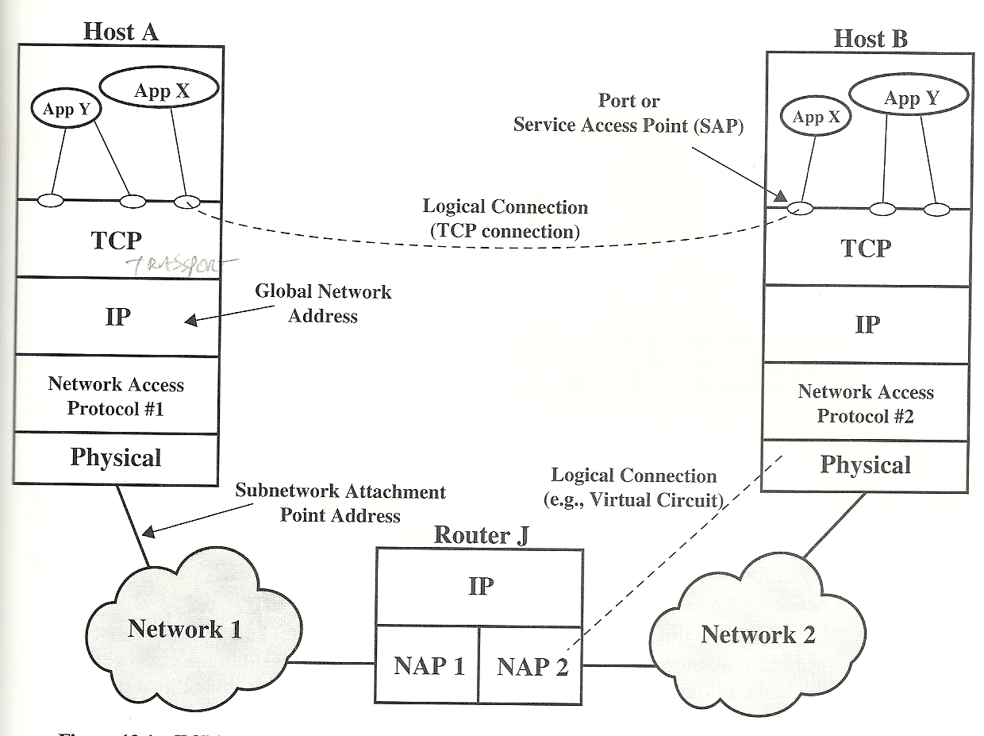
TCP/IP concepts

Slide 13
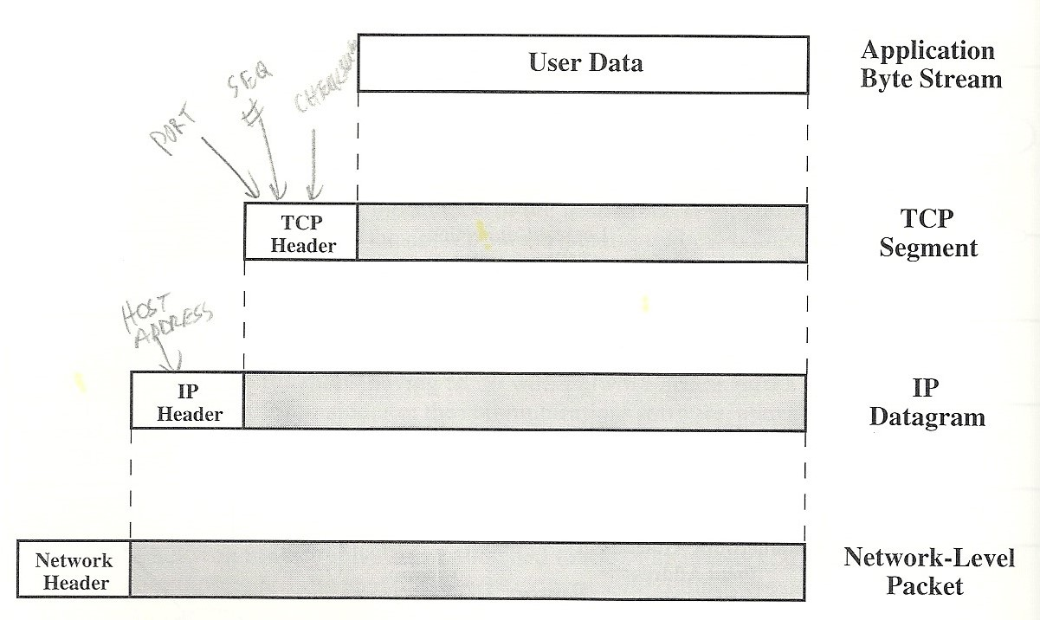
TCP data units

Slide 14
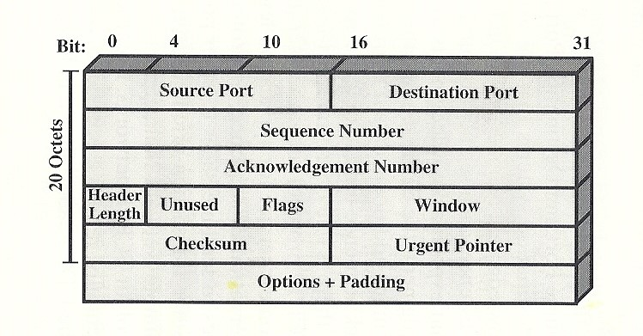
TCP header

Slide 15
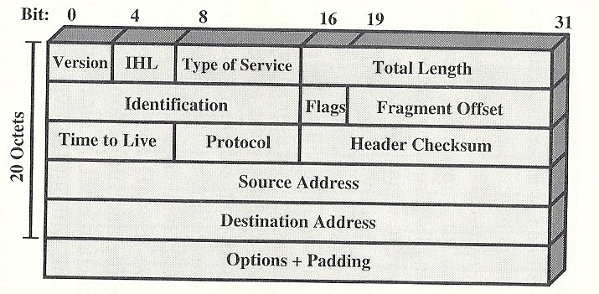
IP header V4

Slide 16
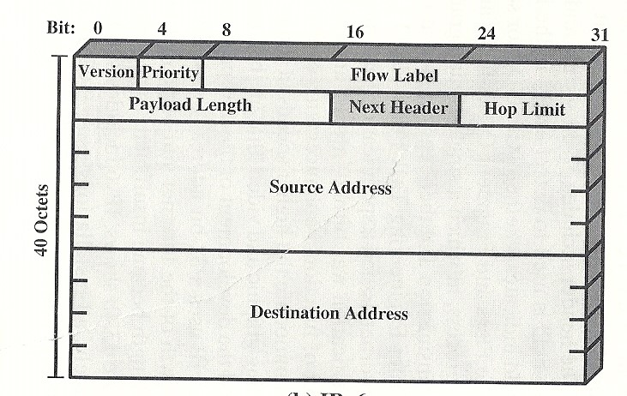
IP header V6

Slide 17
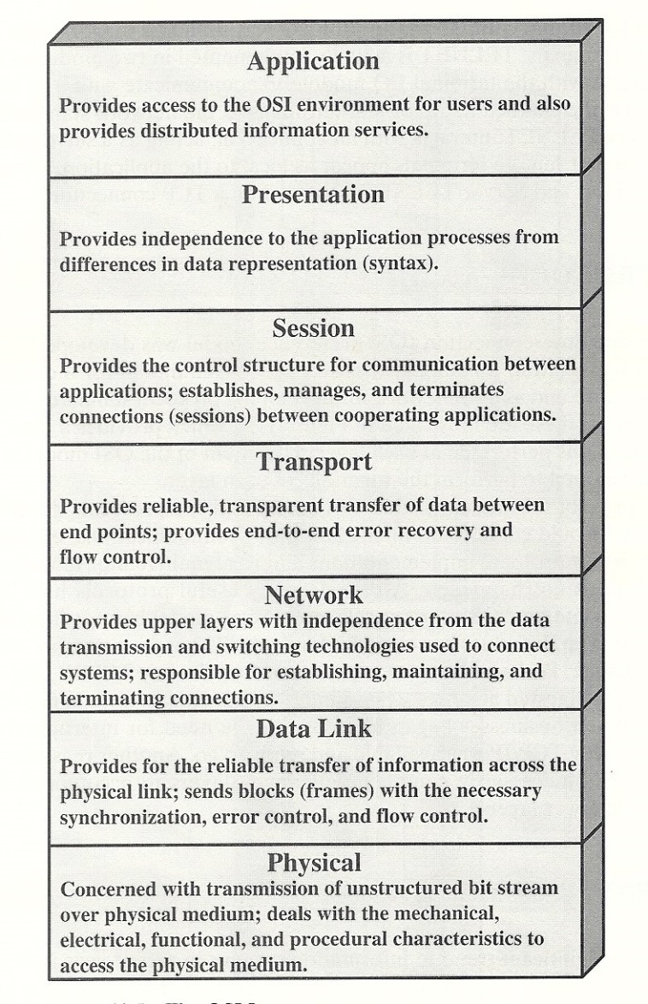
OSI Model

