Slide 1
Chomsky Hierarchy
Regular
Context Free
Context Sensitive
Recursive Enumerable

Slide 2
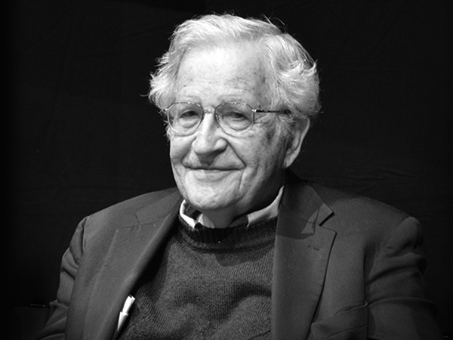
Norm Chomsky
Avram Noam Chomsky (born December 7, 1928) is an American linguist, philosopher,
cognitive scientist, historian, logician,
social critic, and political activist. Sometimes described as "the father of modern linguistics", Chomsky is also a major figure in analytic philosophy, and one of the founders of the field of cognitive science. He has spent more than half a century at the Massachusetts Institute of Technology (MIT), where he is Institute Professor Emeritus, and is the author of over 100 books on topics such as linguistics, war, politics, and mass media. Ideologically, he aligns with anarcho-syndicalism and libertarian socialism.

Slide 3

Regular FA
Example) L = { $a{(ba)}^{∗}$}

Slide 4

Regular Grammar
Example) L = { $a{(ba)}^{∗}$}
$$S→aX$$
$$X→baX|ε$$
And by a left linear grammar
$$S→Sba|a$$

Slide 5
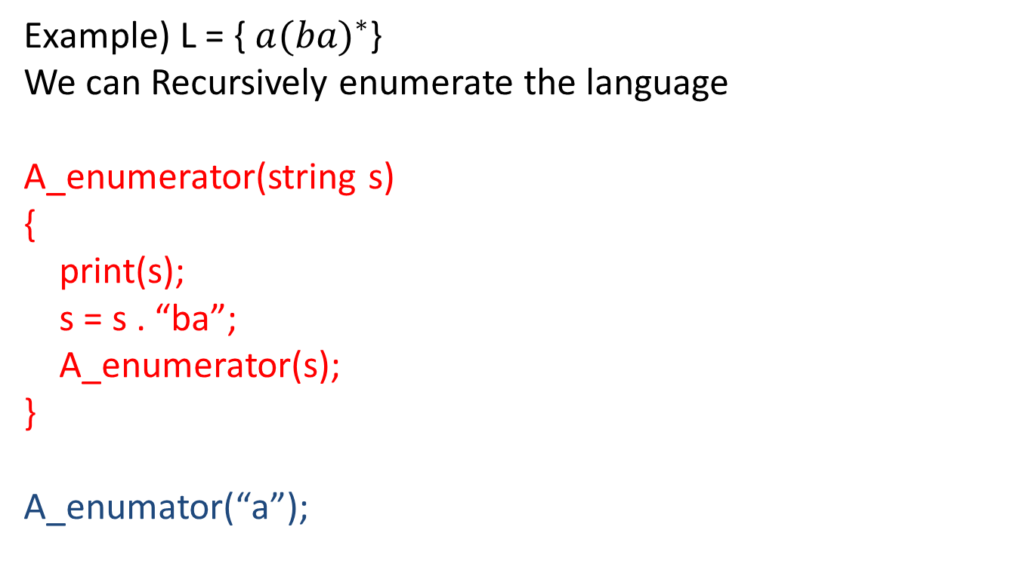
Regular Language Enumerated
Example) L = { $a{(ba)}^{∗}$}
We can Recursively enumerate the language
A_enumerator(string s)
{
print(s);
s = s . “ba”;
A_enumerator(s);
}
A_enumator(“a”);

Slide 6
Properties of Regular Languages
A finite state automata decides the language
A Left/Right linear grammar exists for the language

Slide 7

Context Free language
Example) L = { $a^{i}b^{i}$ | i > 0}

Slide 8

Context Free Grammar
  Example) L = { $a^{i}b^{i}$ | i > 0}
  $$S→aSb | ab$$

Slide 9
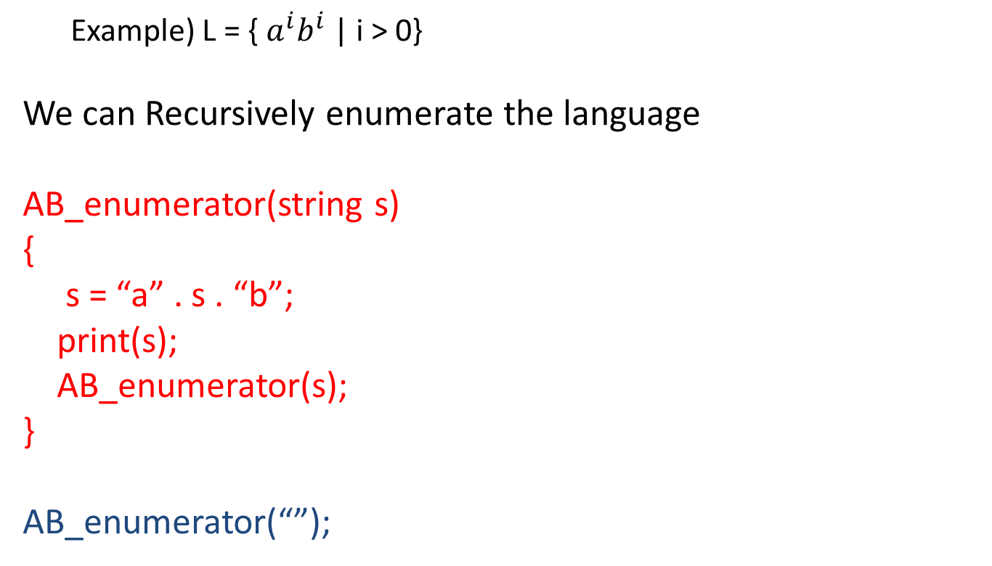
Context Free Grammar
  Example) L = { $a^{i}b^{i}$ | i > 0}
We can Recursively enumerate the language
AB_enumerator(string s)
{
s = “a” . s . “b”;
print(s);
AB_enumerator(s);
}
AB_enumerator(“”);

Slide 10
Properties of Context Free Languages
Are decided by a FA with a Stack
(a.k.a Pushdown Automata)
Expressed by a Context Free Grammar

Slide 11
Subset of English Grammar
<Sentence> → <Subject><Predicate>
<Subject> → <Adjective><Subject> | <Noun>
<Predicate> → <adverb><Predicate> | <Verb>
<Adjective> → “the” | “brown” | “big” …
<Adverb> → “loudly” | “quitely” …
<Noun> → “dog” | “person” …
<Verb> → “barked” | “spoke” …

Slide 12
Parse this sentence
The big brown dog loudly barked.
<Sentence>
<Subject><Predicate>
The <Subject><Predicate>
The big <Subject><Predicate>
The big brown <Subject><Predicate>
The big brown <Noun><Predicate>
The big brown Dog<Predicate>
The big brown Dog barked <Predicate>
The big brown Dog loudly <verb>
The big brown Dog loudly barked. → yes

Slide 13
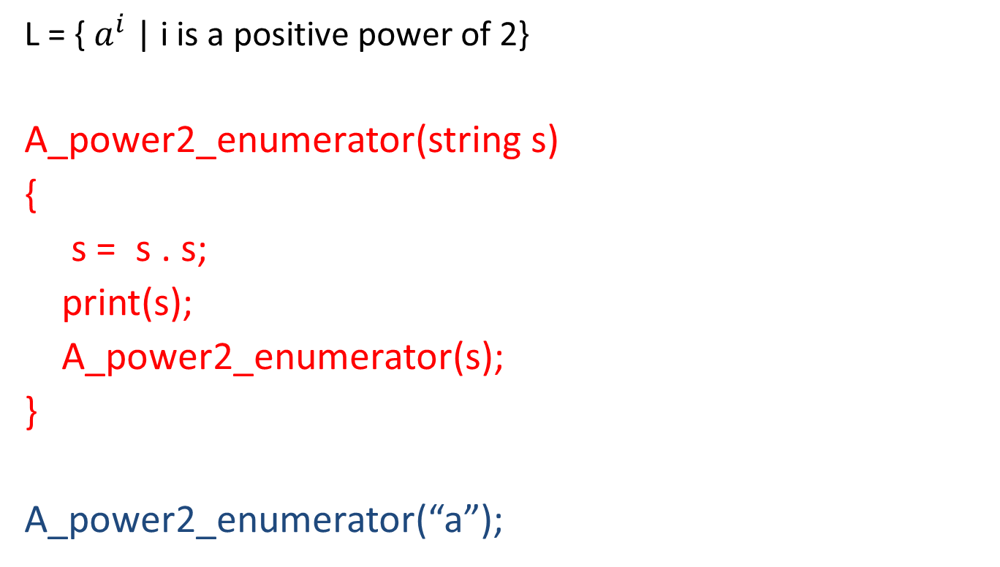
Consider this language
  L = { $a^{i}$ | i is a positive power of 2}
A_power2_enumerator(string s)
{
s = s . s;
print(s);
A_power2_enumerator(s);
}
A_power2_enumerator(“a”);

Slide 14
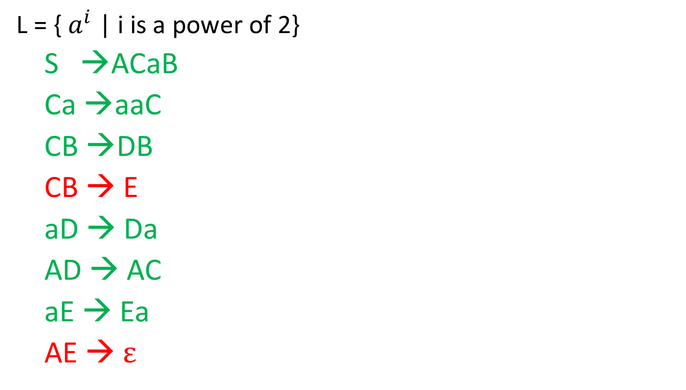
Grammar for this language
  L = { $a^{i}$ | i is a power of 2}
S →ACaB
Ca →aaC
CB →DB
CB → E
aD → Da
AD → AC
aE → Ea
AE → $ε$

Slide 15
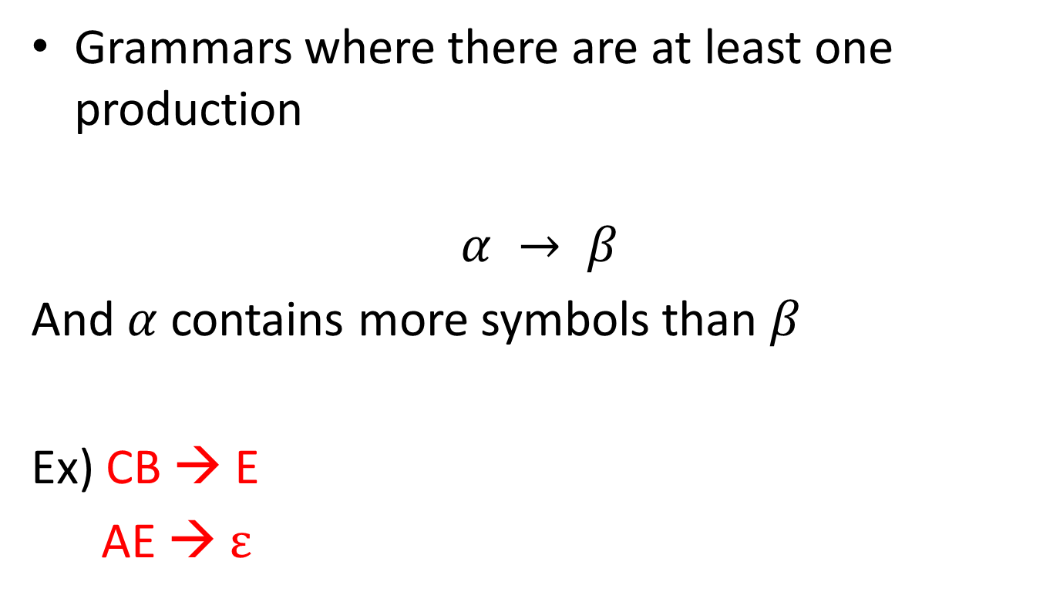
Unrestricted Grammars
Grammars where there are at least one production
$$α → β$$
And $α$ contains more symbols than $β$
Ex) CB → E
AE → $ε$

Slide 16
Enumerating the Universal language
Example) L = {w | all combinations of a’s and b’s}
We can Recursively enumerate the Universal language
U_enumerator(string S)
{
Sa = S . “a”;
Print(Sa);
Sb = S . “b”;
Print(Sb);
U_enumerator(Sa);
U_enumerator(Sb);
}
A_enumator(“”);
Output: a, b,
aa, ab, ba, bb,
aaa, aba, baa, bba, aab, abb, bab, bbb, …

Slide 17
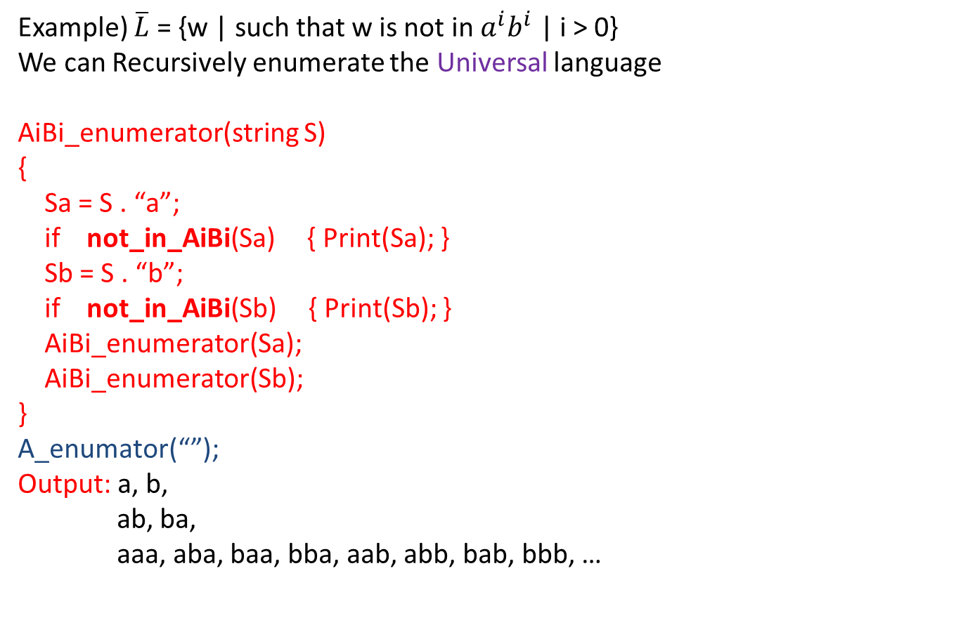
Enumerating a Compliment
Example) $\overline{L}$ = {w | such that w is not in $a^{i}b^{i}$ | i > 0}
We can Recursively enumerate the Universal language
AiBi_enumerator(string S)
{
Sa = S . “a”;
if not_in_AiBi(Sa) { Print(Sa); }
Sb = S . “b”;
if not_in_AiBi(Sb) { Print(Sb); }
AiBi_enumerator(Sa);
AiBi_enumerator(Sb);
}
A_enumator(“”);
Output: a, b,
ab, ba,
aaa, aba, baa, bba, aab, abb, bab, bbb, …

Slide 18
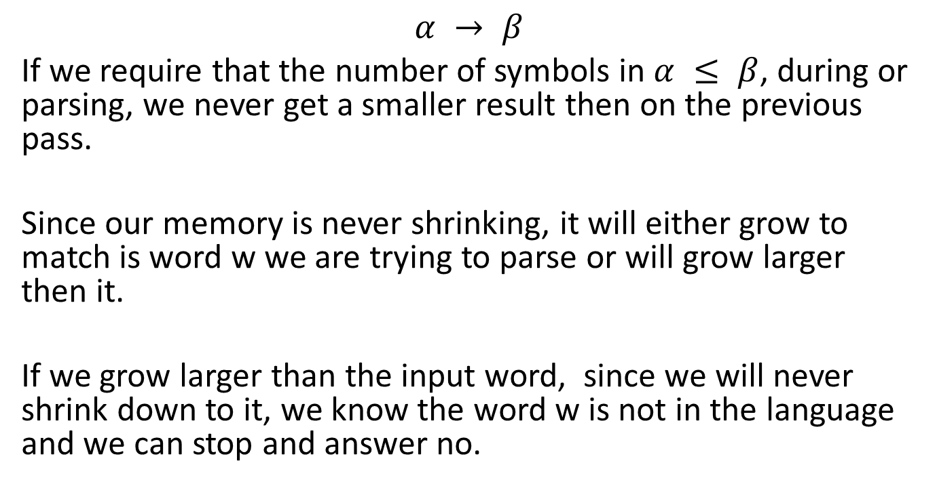
Restricted Grammars
$$α → β$$
If we require that the number of symbols in $α ≤ β$, during or parsing, we never get a smaller result then on the previous pass.
Since our memory is never shrinking, it will either grow to match is word w we are trying to parse or will grow larger then it.
If we grow larger than the input word, since we will never shrink down to it, we know the word w is not in the language and we can stop and answer no.

Slide 19
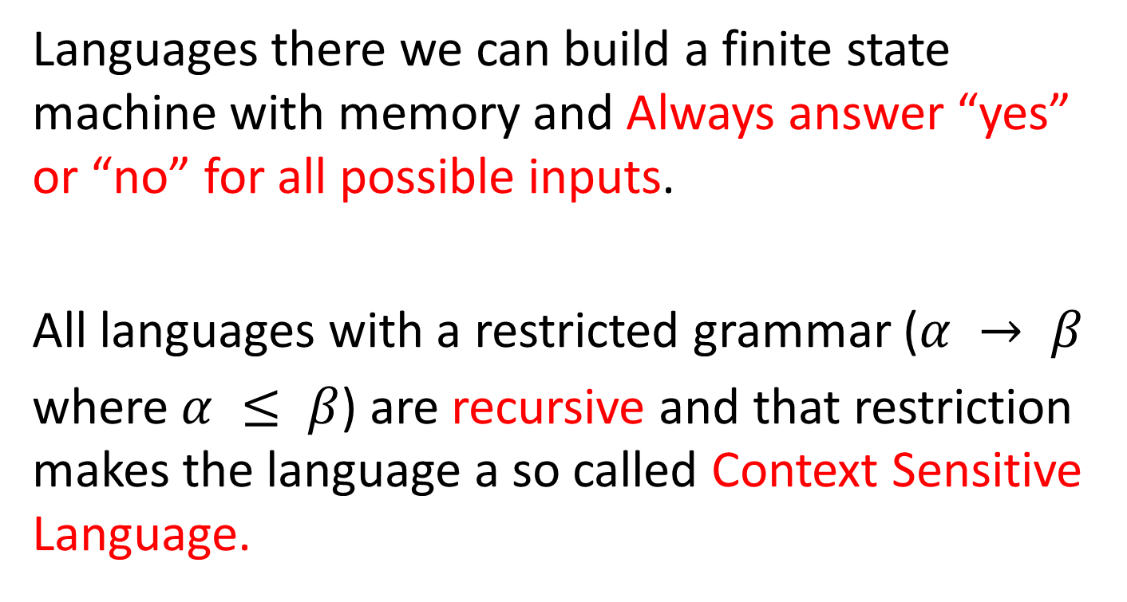
Recursive Languages
Languages there we can build a finite state machine with memory and Always answer “yes” or “no” for all possible inputs.
All languages with a restricted grammar ($α → β$
where $α ≤ β$) are recursive and that restriction makes the language a so called Context Sensitive Language.

Slide 20
Recursively Enumerable Languages
Languages where we can build a Finite State Machine with memory and can always answer “yes” for inputs where the answer is “yes” but if the answer is “no”, the machine may go into an infinite loop.
Example) The Halting Problem (by Turing)

Slide 21
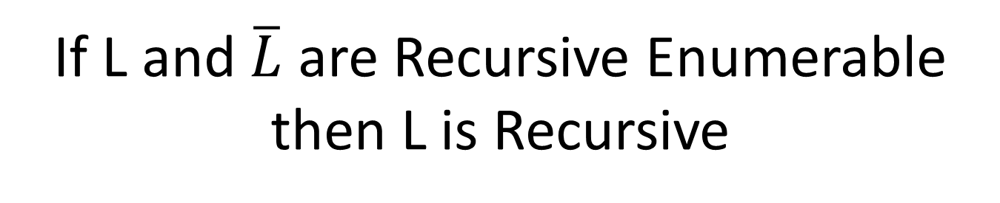
If L and $\overline{L}$ are Recursive Enumerable then L is Recursive

Slide 22
The Chomsky Hierarchy

