Slide 1
Calendar Time
Recording time
Calendars
Events (start and stop and duration)
UTC and GMT

Slide 2
Events
Event: Denver Broncos at San Francisco 49ers
Date: November 18, 2018
Time: 1pm ET
Denver is on Mountain Time
San Francisco is on Pacific Time
But the games start time is in Eastern Time. Why?

Slide 3
Events
Event: Denver Broncos at San Francisco 49ers
Date: November 18, 2018
Time: 1pm ET
How should we record this start time in a database?

Slide 4
Events
Event: Denver Broncos at San Francisco 49ers
Date: November 18, 2018
Time: 1pm ET
Suppose today is 10-25-2018 and we want to calculate how many days from now the game is?
(2018-11-18) – (2018-10-25) = 24 days
Do we calculate
(year-year) * 365 + (month-month)*30 + day - day

Slide 5
Events with start and stop time
Event: 3rd shift employee meeting
Date: November 18, 2018
Start: 11:00pm
Stop: 1:30am
The stop date is not the same as the start date.
How would you calculation the duration of the meeting? 2.5hours

Slide 6
Time displayed in different zones
Suppose you are in New Jersey (USA) and your record a time in a database
A website in India wants to display this in local time (11:30pm)
Then do the time conversions.

Slide 7
Issues to resolve
Months have different amounts of days
Years have 365 or 366 days
Hours from future days may be lower then current hours
Time zone differences.

Slide 8
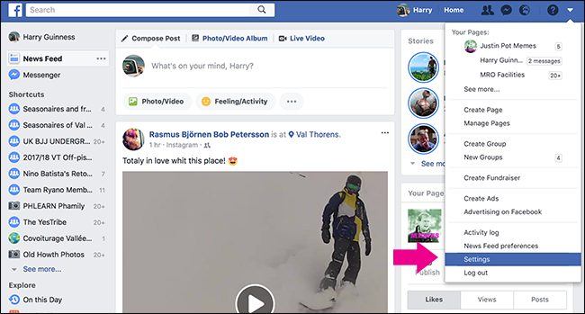
Upload a picture on facebook

Slide 9
Unix Time
UNIX is an Operating System developed (in New Jersey) and unofficially “started” on January 1, 1970.
By recording time as the number of seconds since 1970-1-1 at 00:00:00 we don’t need to record years, months, days, hours, minutes, AMPM etc.
We just need a timezone to be the official timezone of the world. So will use GMT and translate to any local time.
conversion https://www.epochconverter.com

Slide 10
Greenwich Mean Time
Greenwich Mean Time or GMT is clock time at the Royal Observatory in Greenwich, London. It is the same all year round and is not affected by Summer Time (Daylight Saving Time) clock changes.
When the sun is at its highest point exactly above the Prime Meridian , it is 1200 noon at Greenwich.

Slide 11
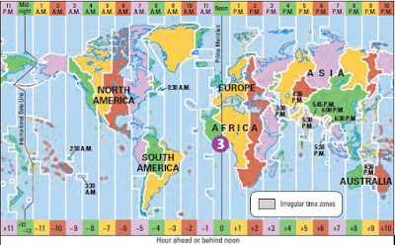
Time zones of the world

Slide 12
Seconds in a…
Minute = 60
Hour = 3600
Day = 86,400
Year (365) = 31,536,000
Range on a 32 bit signed integer
2,147,483,647 (or hexadecimal 7FFF,FFFF₁₆)
-2,147,483,648 (or hexadecimal 8000,0000₁₆)
So we can record ~68 years before and after “1970/1/1”
with a 32 bit integer (1902 - 2038) then we need more bits.

Slide 13
php code to read from database
$DBconnection = loginDatabasei();
$sql = "SELECT eventname,start
FROM attendanceeventsgroupsstartstop
WHERE eventid ='$eventID' and groupid='$groupID'";
$eventResult = submitSQLstatementi($sql,$DBconnection);
logoffDatabasei($DBconnection);

Slide 14
php code make human readable
if ($eventResult)
{
$row = $eventResult->fetch_row();
$eventName = $row[0];
$start = $row[1];
$stop = $row[2];
date_default_timezone_set('EST5EDT');
$startDay = date('m/d/Y', $start);
$startHour = date('h', $start);
$startMinute = date('i', $start);
$startAMPM = date('A', $start);
}

